Slide 1


Slide 2

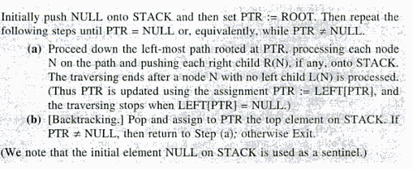

Slide 3
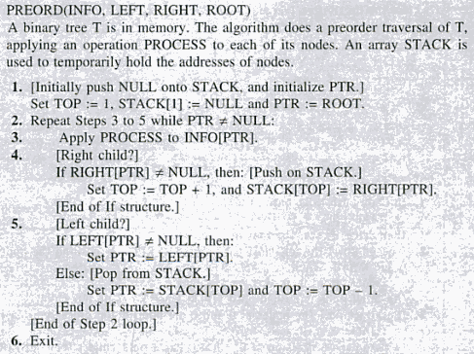

Slide 4

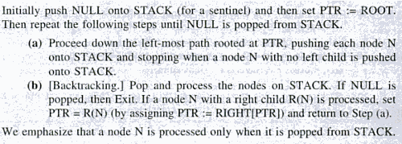

Slide 5
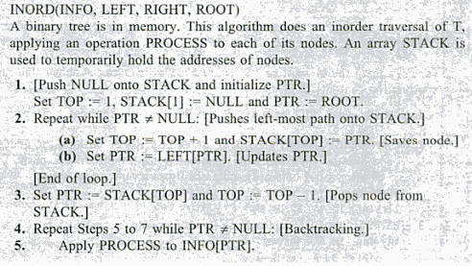
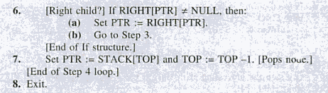

Slide 6

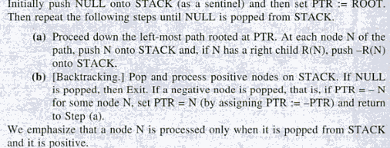

Slide 7
1.[push Null onto stack and initialize PTR]
Set top=1,stack[1]=Null and PTR=ROOT
2.[push left most path onto stack]
Repeat steps 3 and 5 while PTR!=Null
3.Set top=top+1 and stack[top]=PTR[pushes PTR onto the stack]
4.If right[PTR]!=null then:[push on stack]
Set top=top+1 and stack[top]=-Right[ptr]
5.Set PTR=Left[PTR]updates pointer PTR[end of step 2 loop]
6.Set PTR=stack[top] and TOP=TOP-1
[pops nod from stack]

Slide 8
7.Repeat while ptr>0
Apply process to InFO[PTR]
Set PTR=STack[TOP} and TOP=TOP-1
[pops node from stack]
[end of loop]
8 if PTR<0 then
Set PTR=-PTR
Goto step 2
[End of if structure]
9 Exit.

